Slide 1

WOMEN EMPOWERNMENT

Slide 2

WOMEN EMPOWERNMENT
Women empowerment is about investing in women’s capabilities and empowering them to exercise their choices and a way to contribute in women’s economic growth and overall development.
It means increasing the strength of a women socially, economically and emotionally.

Slide 3
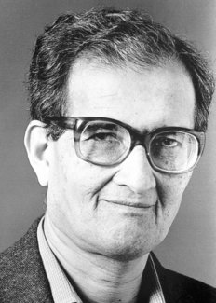
AMARTYA SEN
Amartya Sen, (born November 3, 1933, Santiniketan, India).
Indian economist who was awarded the 1998 Nobel Prize in Economic Sciences for his contributions to welfare economics and social choice theory and for his interest in the problems of society’s poorest members.
Sen was best known for his work on the causes of famine, which led to the development of practical solutions for preventing or limiting the effects of real or perceived shortages of food.

Slide 4

Dr. Amartya Sen’s Contribution to the concepts of women empowerment
Missing Women
Prof. Amartya Sen coined the concept of 'Missing Women' in the late 1980s.
High female mortality rate.
Gender Inequality
Missing number of in the world, who are literally not alive due to the family neglect and discrimination.
The survey done by Dr. Amartya Sen in 1986 disclosed the number of missing women in India - 37 million and China - 44 million and more than 100 million women were missing all over the world.

Slide 5

Literacy and Education
Nearly two-fifths of girls enrolled in primary school, drop out before grade 5.
In India the female literacy rate according to the 2001 census was 54.03% as against 75.64% males.
The reluctance to educate girls is rooted in society's overall perception of the status of women.
Women's Health
Studies reveal that women are new prone to diseases than men.
Due to insufficient caloric intake.
The girl child gets less nutrition, and health care.
Every year, of the 12 million girls born in India, 1.5 million die before their first birthday and another 8,50,000 die before their fifth birthday. Only 9 million live to the age of 15.
The women are susceptible to many life threatening diseases including vicious malnutrition - disease cycle, tuberculosis, malaria, HIV/ AIDS.

Slide 6
Work and Employment
Facing a double burden because of their duel role as homemaker as well as bread earner.
The percentage of women working outside the home is very negligible.
Fewer job opportunities.
The employment participation rates of women are an average 50% those of men
Very few become supervisors or managers.
They tend to get paid much less. Wage discrimination related to women can observed in any field.
Violence
Violence has led to domination over and against women by men
Issues include beating, sexual abuse of female children in the household, dowry-related violence, martial rape etc.
Worldwide, 20% to 50% experience some degree of domestic violence during married life.
In India rape takes place every 54 minute and dowry death every 1000 minute.

Slide 7
Women's participation in Decision Making and Political Activities
Women are generally restricted to take decisions.
Even when women become economically independent, they are not assumed responsible for major decisions in the home.
It is the key affecting a woman's decisional power within the family, affecting on her social standing, her ability to be independent, her power to articulate, her knowledge of the outside world and her skill in influencing group decisions.
The opportunity of women to aim independently, the property rights of women, the gender status and standing of women in social culture and the involvement of women in gainful activities outside the home are the important factors in his opinion which affect women empowerment. For Dr. Amartya Sen individual freedom is the means of development.

Slide 8
Our Aims To Bring The Change
Women Education
OUR
AIMS
Women
Health
Our Contribution For Women Empowerment

Slide 9

WAYS TO BRING AWARENESS ABOUT EDUCATION
"If you educate a woman, you educate a family, if you educate a girl, you educate the future.“
The female literacy rate in India is less than the male literacy rate.
Aims at improving knowledge and skills of women and girls.
It includes providing general education at schools, colleges and in the various areas of Agra.
Aim at spreading awareness about education.
Conducting various competitions like poster presentation, debate, paper presentation etc.

Slide 10
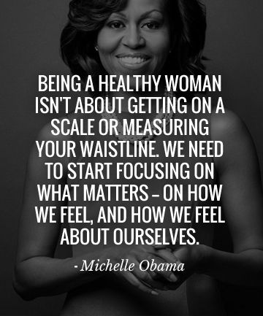
WAYS TO SPREAD AWARENESS ABOUT HEALTH
By concerning with a doctor for campaigning, our idea is to spread awareness about :
Special attention must be given to the essential needs of women and girls at all stages of life cycle.
Almost half of adolescent girls are chronically malnourished.
Importance of providing nutrients.
Health problems due to diseases like malaria, TB, hypertension etc.
Menstrual education.
Hygiene and access to sanitation facilities.
Reproductive rights of women.

Slide 11

Our Initiative to open a new Cell
LAKSHMI BAI CELL
Our idea is to open a Women Empowerment Cell in Anand Engineering College, named LAKSHMIBAI Cell.
This is will be the converging point of all the female “Shakti” in the college.
Group discussions, Plan of Action , Inspirational Posters and the “Shakti” team will be formed here.

Slide 12

“THERE IS NO FORCE MORE POWERFUL THAN A WOMEN DETERMINED
TO RISE”
Help Them To Rise
THANKYOU

